Slide 1
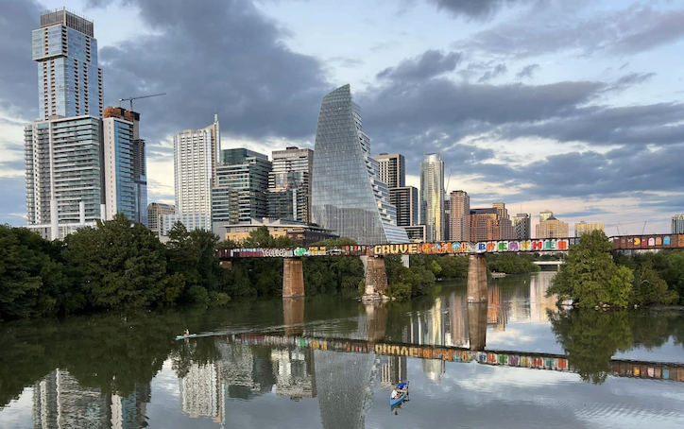

Downtown Safety Forum
Thursday, March 21, 2024
Downtown Safety Forum
Thursday, April 17, 2025
Notes:
Good morning, and welcome to the Downtown Safety Forum for April 2025
I’m Bill Brice, SVP Investor Relations, and on behalf of the Downtown Austin Alliance, it’s my pleasure to welcome you this morning’s Downtown Safety Forum
Thank you for taking time to join us. We appreciate you being on the call this morning.

Slide 2
  Opening Remarks: Bill Brice
  APD Briefing – Commander Michael Chancellor
  HEART ATX program launch
  Downtown Dashboard – Brandon Fahy
    Cleaning
    Hospitality
    Safety
    APD Overtime Patrol
    Unsheltered homeless trend
  Upcoming Events and Conventions – Bill Brice
Open Q&A
Today’s Agenda
Notes:
We’ll start off with a briefing from APD/DTAC Commander Michael Chancellor downtown safety initiatives and crime trends.
Following Cdr. Chancellor, we’ll provide an update on the launch of the HEART ATX homeless outreach program followed by a briefing on the Downtown Dashboard/Downtown Alliance-provided services, a snapshot of upcoming events and open Q&A

Slide 3

Notes:
Before I turn it over to Commander Chancellor, I would like to invite you to join us Tuesday, May 27 for the Future of Downtown at ACL Live.
This high-energy event celebrates downtown’s progress, transformative projects, and spotlights the people and projects that have positively impacted downtown.
This is the downtown Austin Alliance’s signature, annual event, and we encourage you to go to downtownaustin.com for information and tickets.

Slide 4

Commander
Michael Chancellor
Notes:
Now, it is my pleasure to introduce APD/DTAC Commander Michael Chancellor for an update on APD initiatives and crime trends.
Commander, thank you for being with us this morning.
The floor is yours

Slide 5
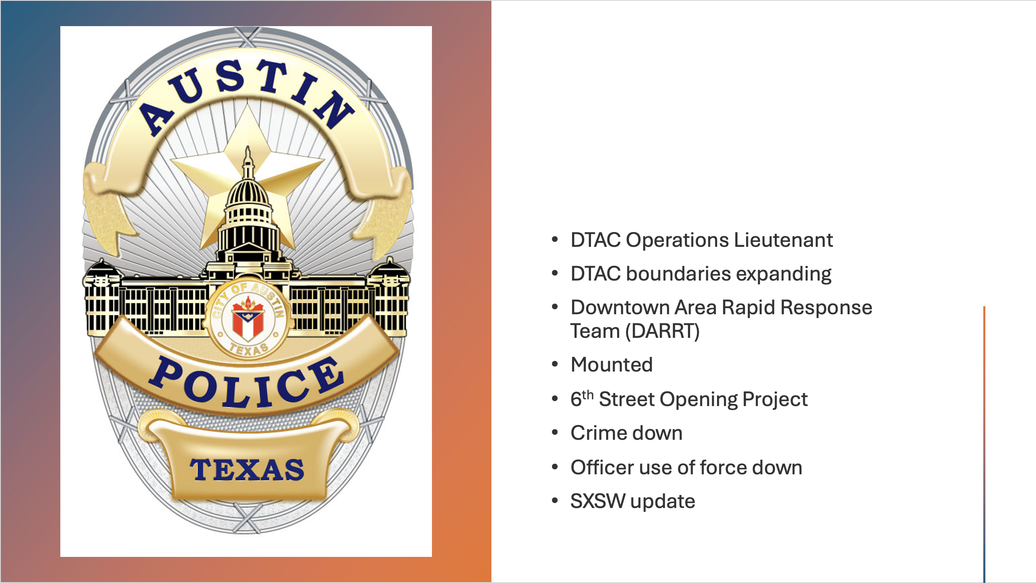
  Crime Trends
  PACE Teams
  Hot Spots
  Neighborhood Watch Programs
Notes:
1. Take questions for commander now

Slide 6

HEART ATX
Notes:
Thanks, Mike. We appreciate your presentation and you staying on the call for open Q&A shortly
Now, I am pleased to announce the launch of the HEART ATX program
As many of you would recall, The Homelessness Engagement Assistance Response Team (HEART) began as a six-month pilot in 2023 that was funded and launched by the Downtown Alliance in February 2024.

Slide 7
HEART ATX Overview
What: HEART ATX (Homelessness Engagement Assistance Response Team)
  Outreach to people experiencing unsheltered homelessness downtown
  Connect to service system, shelter, and housing-focused resources.
Pilot: February 1 through July 31, 2024
  Funded and launched by Downtown Alliance with Urban Alchemy
  Success led to extension through September 30
  City Council approved funding for year-round program, larger geographic area
Funding:
  $440,000 = ongoing city budget funds
  $920,000 = one-time allocation of ARPA funds
  $411,000 = encumbered from FY 24-25 for supplemental services for the PID through FY 25-26
Notes:
The purpose was to test and demonstrate the impact of having homeless outreach in downtown.
We worked with Urban Alchemy – the city’s contract shelter manager for the ARCH and 8th Street shelters – and saw very positive results.
Outreach practitioners - people with lived experience - actively engaged with people living unsheltered downtown 8-hours a day/5-days a week, and this resulted in 120 people being sheltered, 53 reunified with families, and more than 1,400 people being referred to the outdoor Oasis at ARCH.
The success of the pilot and our advocacy to expand the program led to city council committing funding needed to create a year-round program to a larger geographic area across the CBD and into East Austin with an expanded service schedule.
In addition to the city’s funding commitment, the Downtown Austin Alliance has committed $410,000 to put additional HEART outreach services in the PID

Slide 8
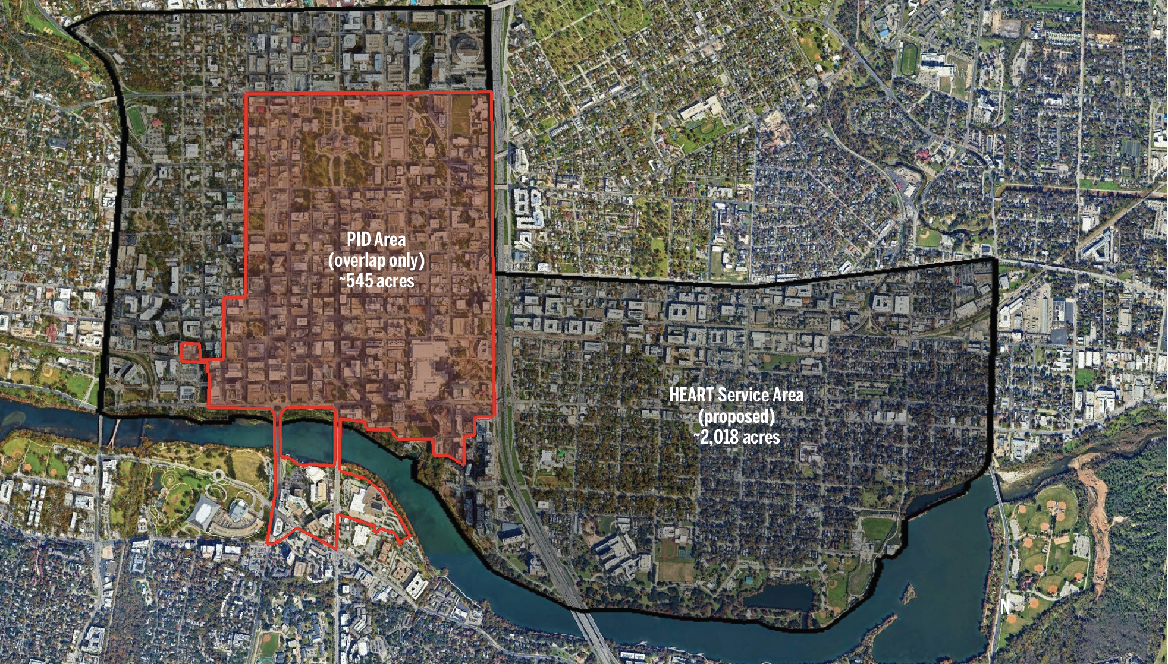
HEART ATX Program & MOU – Service Area
Notes:
The dark-shaded area on the screen represents the entire HEART ATX service area funded by the city.
(Describe boundary)
The red-shaded area represents the Downtown PID
The city’s service schedule that you’ll see in just a moment will provide services throughout the entire shaded area on the screen.
The Downtown Alliance’s supplemental services will be within the red-shaded area only

Slide 9
HEART Program & MOU – Service Schedule
City Contract Schedule (overall service area)
  Monday through Friday:
    1 team 7AM to 3:30PM
    1 team 10:30AM to 7PM
  Wednesday through Saturday:
    Above schedule plus 1 team 7AM to 3:30PM
Downtown PID Supplemental Schedule
  Monday through Saturday:
    1 team 7AM to 3:30PM
Notes:
Review city schedule (overall area on map)
Review DAA-funded supplemental schedule (red shaded area on map)

Slide 10

Notes:
Now, I’ll turn the meeting over to Brandon Fahy, Downtown Austin Alliance Director Downtown Experience to share statistics from our Downtown Dashboard on Downtown Alliance-provided cleaning, hospitality and safety resources.
Good morning, Brandon.
Thanks for joining us this morning.
Thanks Bill.
I’m Brandon Fahy, Director of Downtown Experience, and we appreciate you joining us this morning.
And I’m pleased to provide an update on the Downtown Dashboard.
This information is available on our website at downtownaustin.com
It is updated monthly to provide ongoing, current information on the results of our direct services
Next slide please

Slide 11
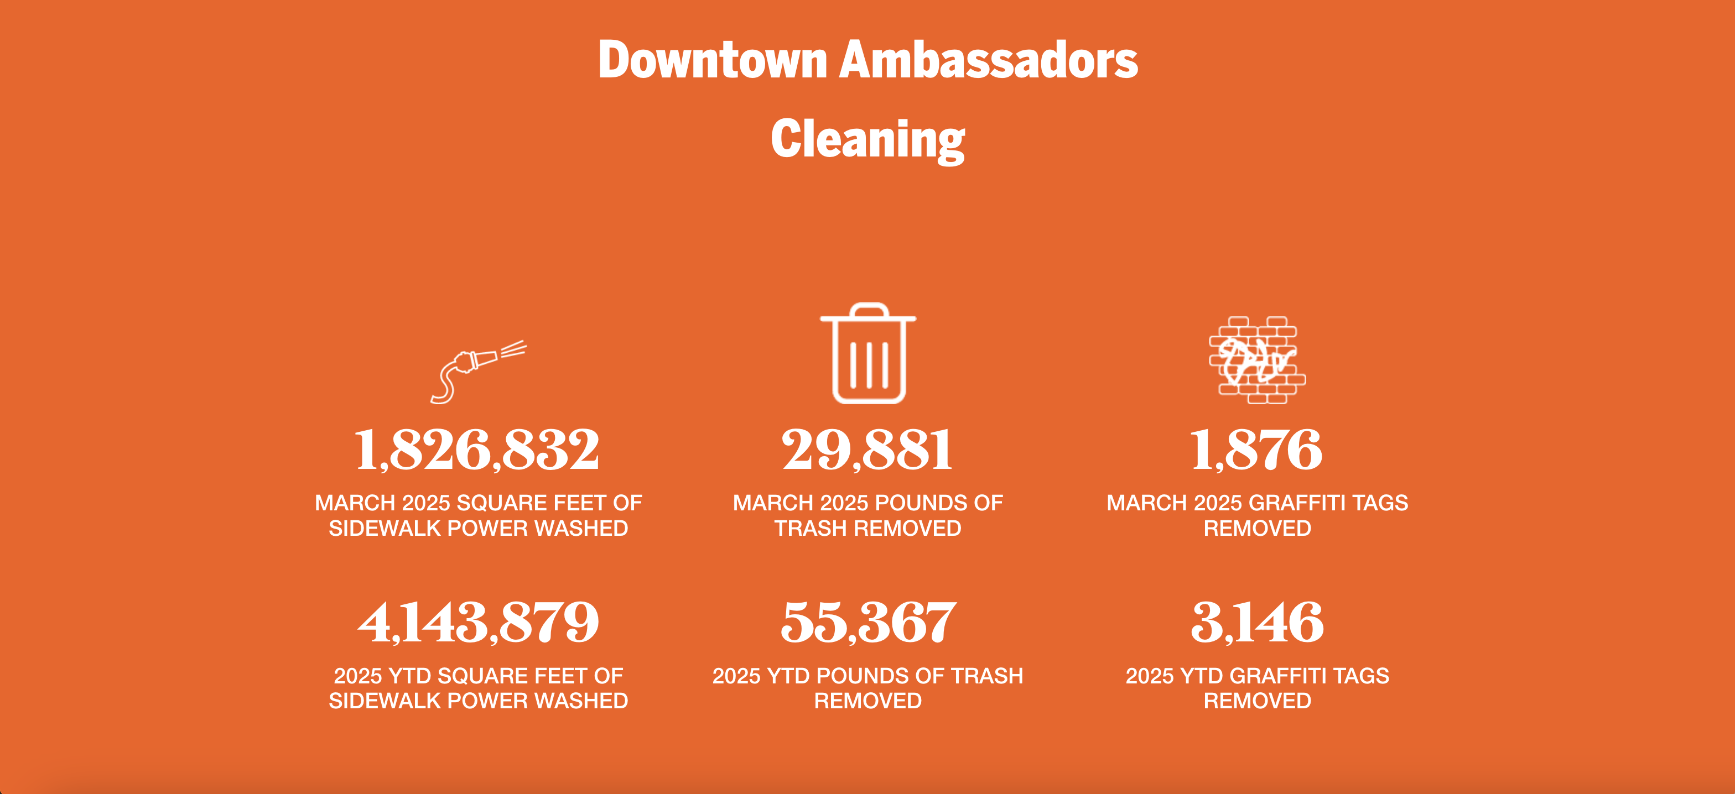
Downtown Dashboard
Notes:
A few highlights on our services to keep downtown clean include pressure washing more that 1.8M square feet of downtown sidewalks in March alone and over 4M year to date.
In March we also removed nearly 1900 graffiti tags
Next slide please

Slide 12
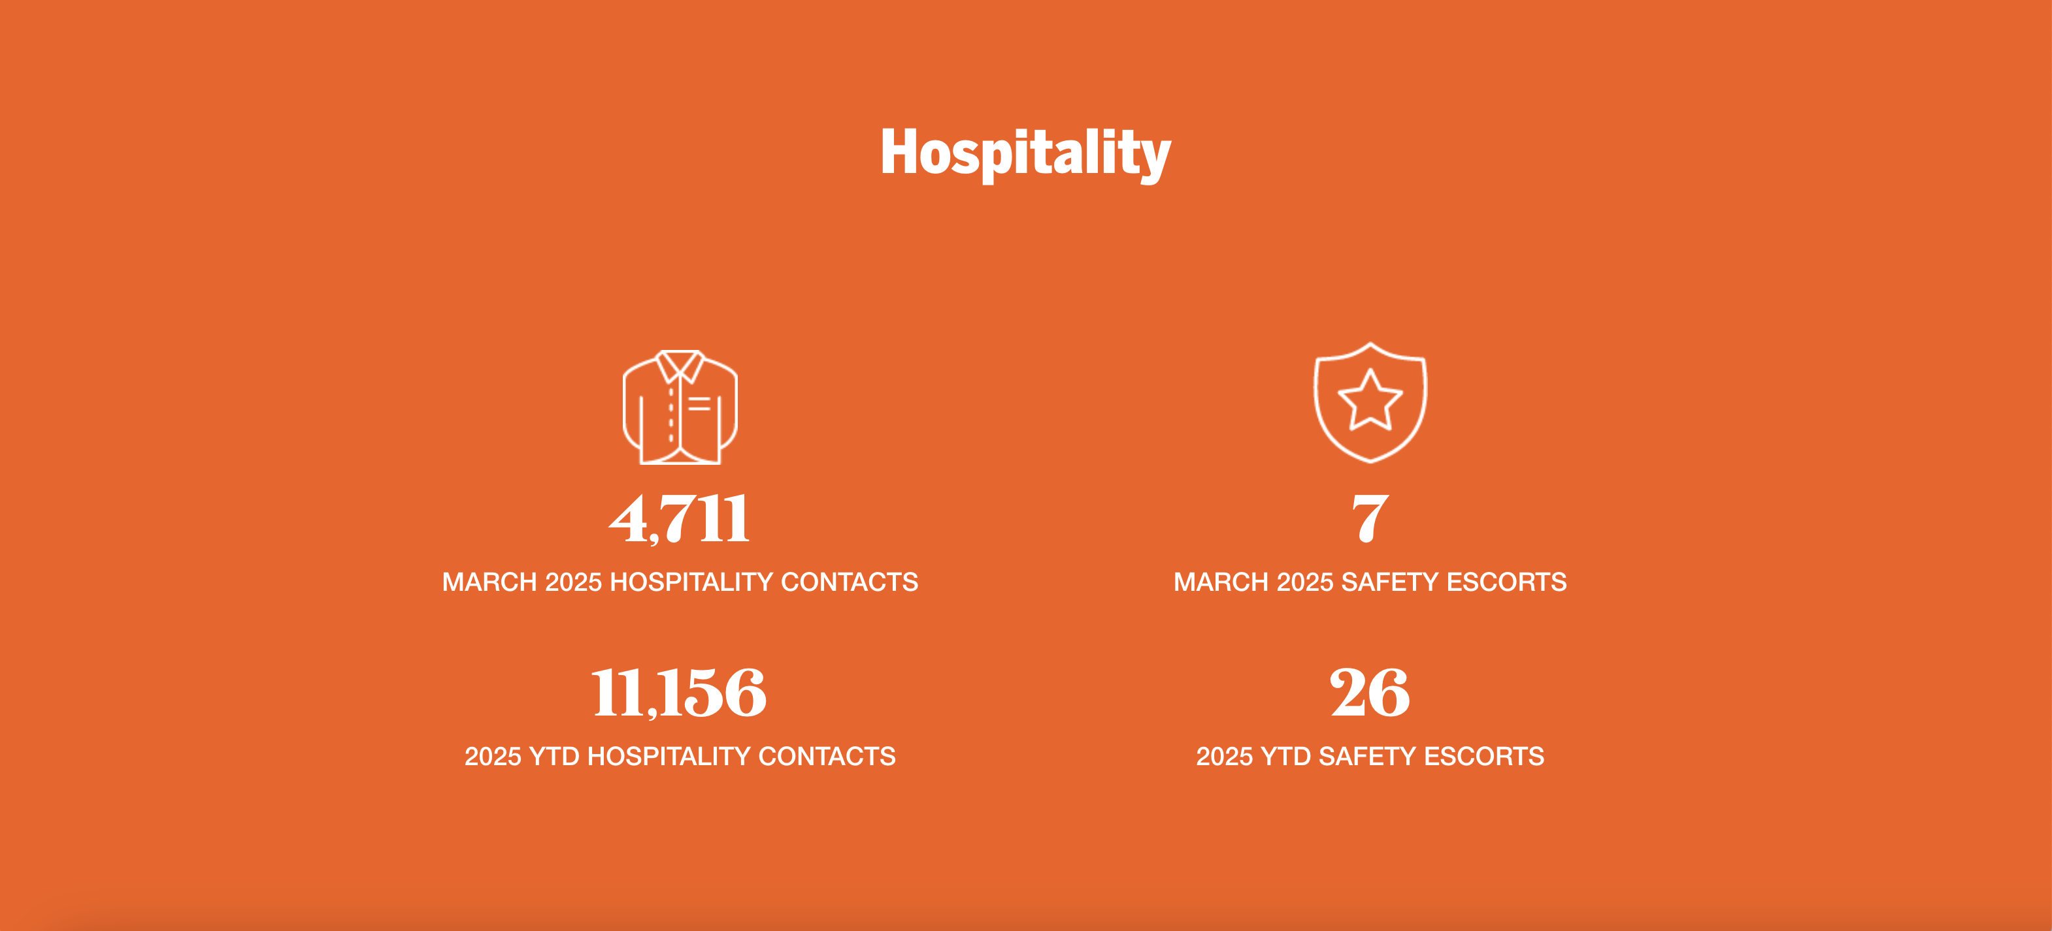
Downtown Dashboard
Notes:
Through March, Downtown Ambassadors made more than 11,000 hospitality contacts with visitors and downtown users
And as you can see, more than 40% of these occurred in March alone.
This is due to March being a peak month for downtown visitors with the many national and international-scale events happening such as SXSW, Texas Relays and Moto GP races.
Next slide please

Slide 13
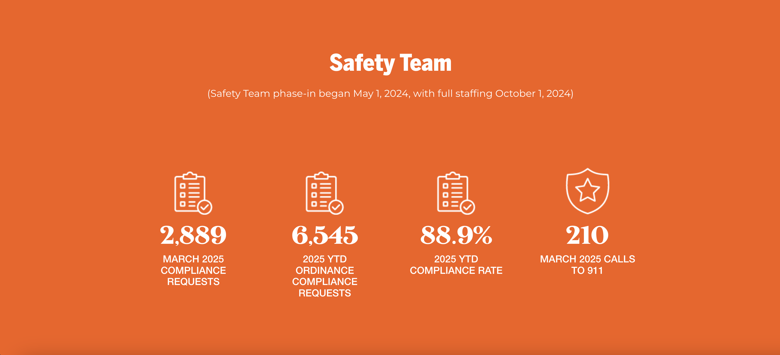
Downtown Dashboard
Notes:
The Downtown Alliance safety team made nearly 2,900 requests for compliance in March and has made more than 6,500 January through March
Ambassadors actively engage with people who appear to be in need of emergency or social services and request compliance from those who are violating city ordinances.
89% of the time a safety team member requests compliance, people comply with the team member’s request to change their behavior.
Next slide please

Slide 14
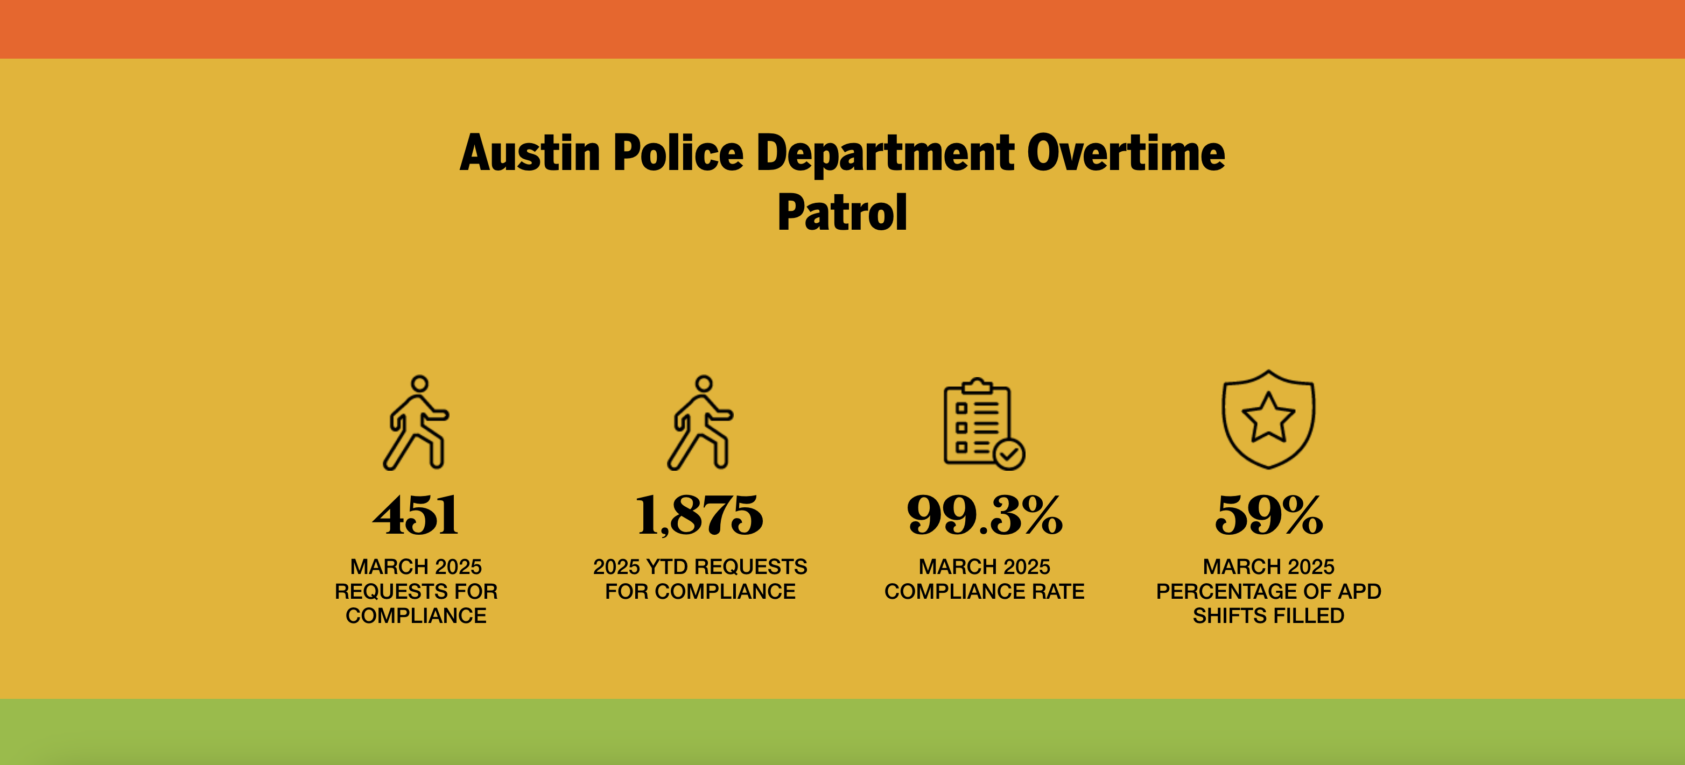
Downtown Dashboard
Notes:
The Downtown Austin Alliance-funded APD overtime patrol provides 2 APD officers from 6AM to 3:30PM daily.
These officers are dedicated to the Downtown PID and actively enforce city ordinances, as well as all other laws.
You can see that from January 1 through March, our overtime patrol officers made nearly 1,900 compliance requests from people who were violating city ordinances with nearly 100% compliance.
Next slide please

Slide 15
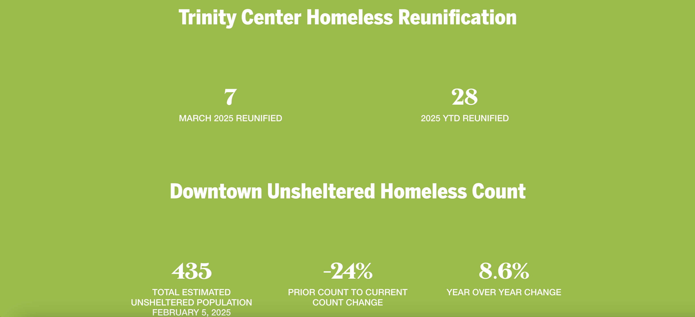
Downtown Dashboard
Notes:
Our stats related to homelessness show that in 2025 to-date, 28 people who were homeless downtown were reunified with their families through the Downtown Alliance-funded Trinity Center Family Reunification program.
In the 12-month period from April 2024 through March 2025, 195 people had their homelessness resolved through this program.
And from the time this partnership began in October 2021, 634 people experiencing homelessness downtown have been reunified with their families.
Next slide please

Slide 16
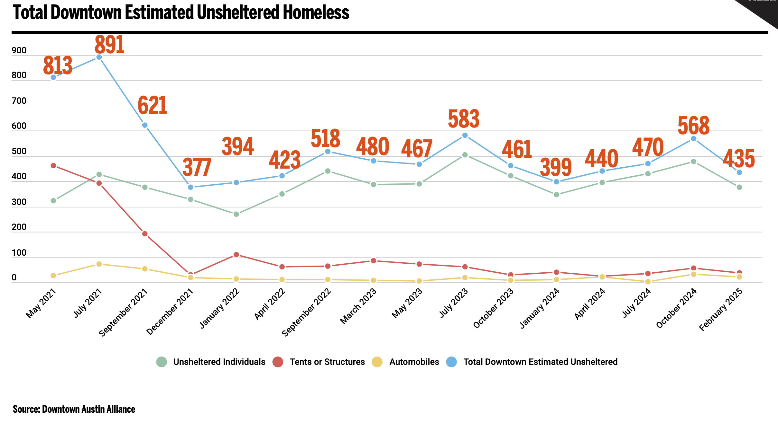
PID Unsheltered Homeless Estimate – February 2025
Notes:
The graph on the screen shows the trend for the total estimated number of people living unsheltered downtown.
This includes the number of individuals counted, as well as the number of tents and structures and vehicles believed to have people living in them.
As you can see, the total estimated number of people living unsheltered in the PID in February was 435.
This estimate is down 23 percent from the October 2024 count.
Our next quarterly unsheltered count is scheduled for 2-6AM, Wednesday, April 23, so we will share the results of that count at our May 15 Downtown Safety Forum.
Next slide please

Slide 17

Downtown Ambassadors Service Requests
Downtownaustin.com/service-request
Notes:
I’d like to remind you that you can now request Downtown Ambassador services online on the Downtown Alliance website at downtownaustin.com/service-request.
I also want to mention that we want to work with all our downtown property owners and managers to coordinate our service provision when you’re showing your properties to prospective tenants.
We will be formalizing this program in our coming fiscal year, but any time you have prospective tenants scheduled to visit your properties, we want to ensure the surrounding area is clean and welcoming.
For these requests, please email me directly at bfahy@downtownaustin.com. I’ll put my email address in the chat momentarily.
We’d ask that you give us much lead-time as possible.
And last, I’d like to remind you that you can find our dashboard updated monthly on our website, and you can also submit ambassador service requests anytime at downtownaustin.com/service-request
Thank you

Slide 18
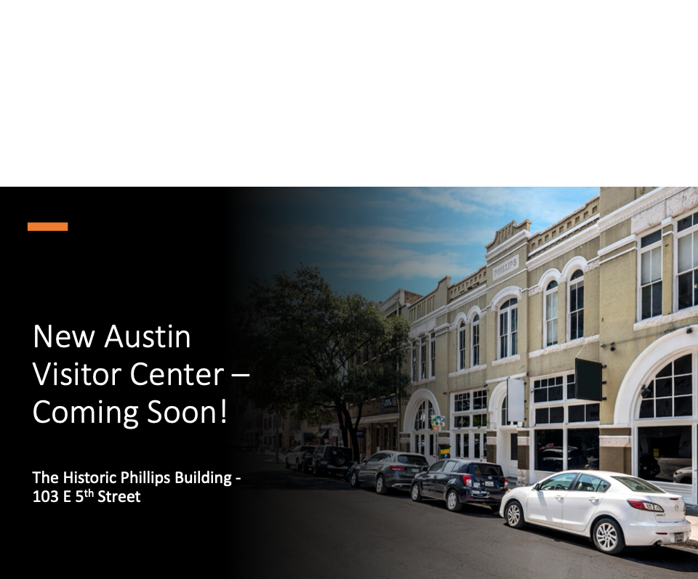
Now Open!
Notes:
As a reminder, we are very excited to have the visitor center in the heart of downtown and to the many visitors and increased foot traffic this will bring with it.
And we congratulate Visit Austin on this fantastic and important asset that will bring a lot of foot traffic and positive activation to this block.
We encourage you to stop by the visitor center from 8AM to 5PM and to pick up a cup of coffee, snack or gift while you’re there.

Slide 19
Upcoming Conventions & Events
April
Now-19 / Moontower Comedy Festival @ Paramount Theater
18-20 / Austin Reggae Festival @ Auditorium Shores
21-25 / ESO Solutions @ JW Marriott Austin
25-24 / Field Guide Festival @ Fiesta Gardens
May
3-5 / The Front Market @ Distribution Hall
12-15 / T-Mobile USA Winners Circle @ Fairmont Austin
10 / O. Henry Museum Pun-Off @ Brush Square Park
14-18 / Cine Las Americas International Film Festival @ Various locations
22-25 / Hot Luck Live Food & Music Festival @ Franklin BBQ
26 / CapTex Tri @Various Locations Throughout Downtown
27-30 / International Site Alliance 11th Annual Conference @ Fairmont Austin
29-Jun 1 / ATX Television Festival @ Various locations
June
9-11 / Partnerships Experience (iPX) @ Palmer Events Center
Notes:
Upcoming events and conferences in the coming weeks will bring many visitors and locals to downtown
ATX Television Fest - Heading into our 14th Season, the festival showcases past, current, and upcoming series through reunions, screenings, intimate Q&As, panel discussions, events, and more.
Note that the CapTex Triathlon takes place on Memorial Day, Monday May 26. Swimming component occurs on LadyBird lake and running/cycling events require road closures throughout downtown and surrounding areas.
We thank Visit Austin for providing this information and congratulate them on the opening of the new visitor center.

Slide 20
Open Q&A
Upcoming Forums & Events:
Downtown Safety Forum
Thursday, May 15, 2025
8:30-9:30 a.m. (via Zoom)
Future of Downtown
Tuesday, May 27
4:30 – 7:30 p.m.
ACL Live at the Moody Theater
Notes:
Now as we move to open Q&A, I’ll share this reminder of May 15 Downtown Safety Forum and our Future of Downtown event Tuesday, May 27.
We encourage your participation in these upcoming events and forums.
And now we will open the meeting to take your questions

