Slide 1
Issues & Eggs with Chief Lisa Davis
Austin Police
Department
November 19, 2024

Slide 2
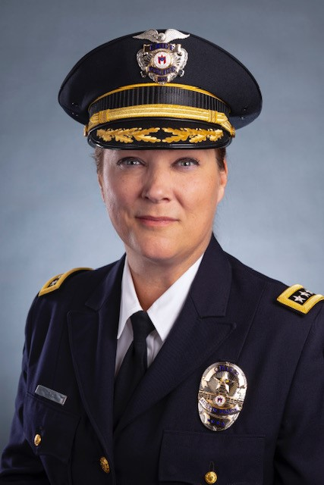
Chief of Police Lisa Davis
Austin Police Chief Lisa Davis is the second woman in Austin’s history to serve as permanent Chief of Police. Her career spans more than three decades with the Cincinnati Police Department, where she served as Assistant Chief and Investigations Bureau Commander, which oversees homicide, major offenders, narcotics, and personal crimes.
Throughout her career, she served in multiple roles, specialized in building community relationships, used problem-solving, and evidence-based policing to address crime and disorder. In Cincinnati, she created a city-wide problem-solving unit trained to address crime and disorder in chronically violent locations, reducing overall crime and increasing the quality of life for community members.
Chief Davis is passionate about community policing and building police legitimacy through community partnerships. By developing a specialized unit, she addressed the at-risk population victimization that includes the LGBTQIA+ community, Latino/Hispanic community, human trafficking victims, and youth experiencing homelessness.
In addition to receiving her bachelor’s degree from Xavier University, Chief Davis has received several awards for her work, including Superior Achievement in Law Enforcement and the Award of Valor.
2

Slide 3
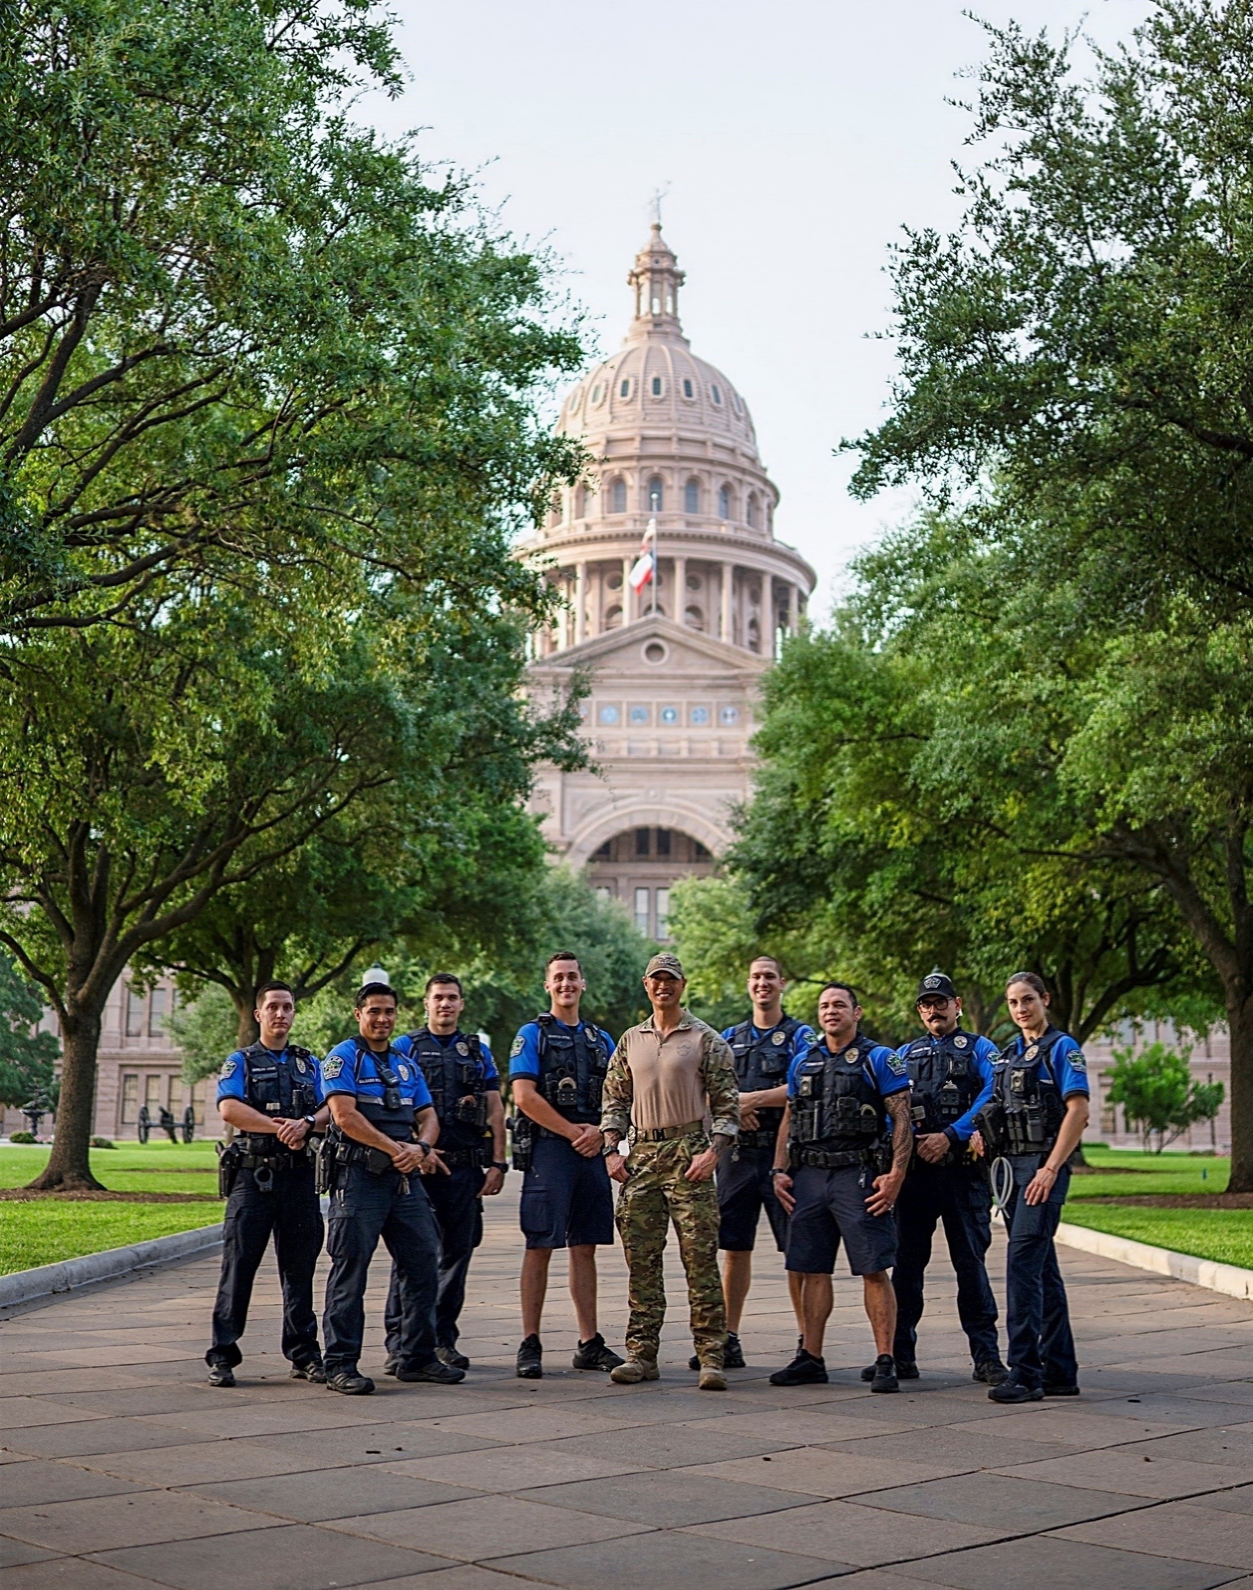
APD Mission
A department that is trusted and respected by all and collaborates with our community to make Austin the safest city in America.
3

Slide 4
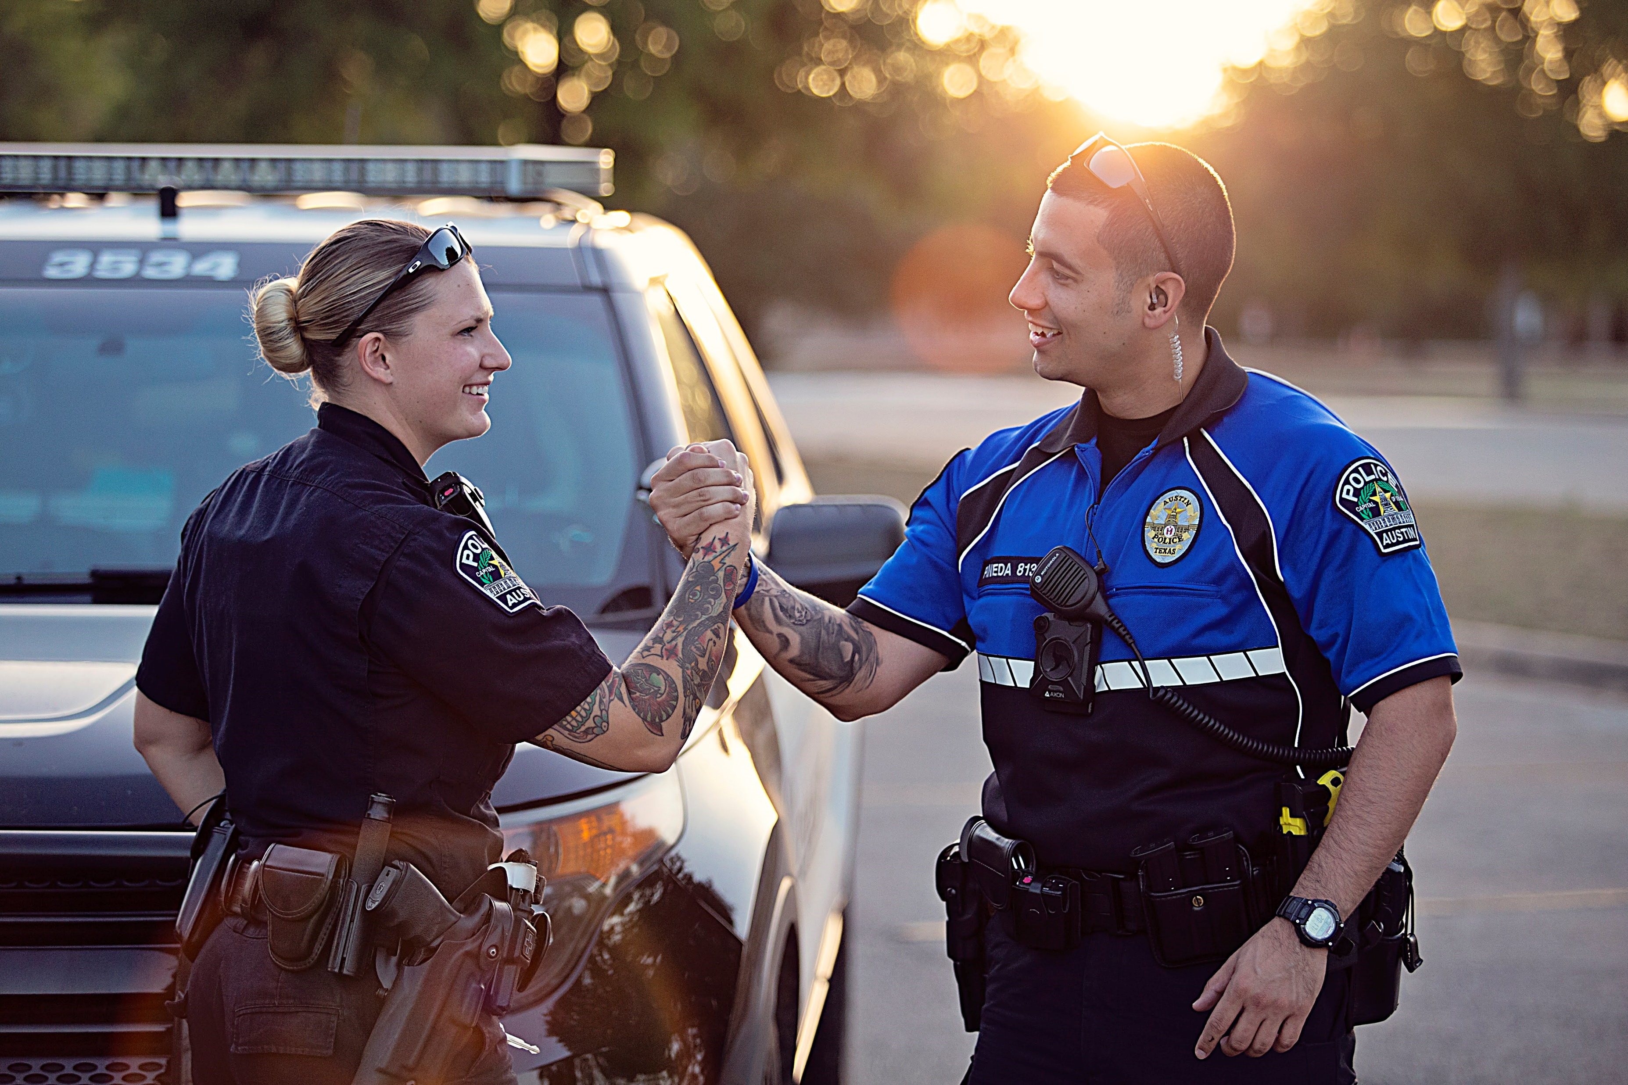
100-Day Action Plan Summary
Transparency in action: Building Officer and Community Safety and Trust
3 Key Priority Areas:
APD Recruitment, Retention & Morale
Community Trust & Crime Prevention
APD Capacity for Excellence & Innovation
4

Slide 5
100-Day Key Objectives
Listen
Learn
Look
Launch
Listen to your experiences and concerns. Seek to understand your perspectives and make informed decisions that will directly address your needs and expectations.
Learn through comprehensive assessments that will provide the foundation for data-driven decisions.
Look for collaborative solutions that are practical, evidence-based, and meet the community’s needs.
Launch strategic initiatives and regularly communicate actionable results of our progress.
5

Slide 6
Phase One: Listen
Examples of Listening Opportunities
Community Members & Faith-based Leaders
Police Association & Officer Focus Groups
Justice & Social Service Organizations
City Council & Other City Leadership
Town Halls & Media
Ride-outs, Officer Show-ups & Unit Visits
Business & Community Gatherings
I will be visible and accessible to our Austin PD team and the community.
Your voices matter and will help me develop a strategic roadmap for the future of public safety in Austin.
6

Slide 7
Phase Two: Learn
Institutions
Culture & Stories
Individuals
Associations
Infrastructure
Local Economy
I am committed to learning about existing APD functions and community resources.
Our personnel and the community are best positioned to help inform assessments and evaluations of our current policies, practices and resources.
7

Slide 8
Phase Three: Look
Identify Key Priorities
Listen and Assess
Consider Various Viewpoints
Ask those Impacted to Help Design Solutions
Continuously Adjust Based on Feedback
I will look for collaborative, creative and promising solutions to meet existing and future challenges.
Our collaborative work will bring together diverse perspectives, experiences and expertise, leading to more effective and comprehensive solutions.
Collaborate & Formulate
8

Slide 9
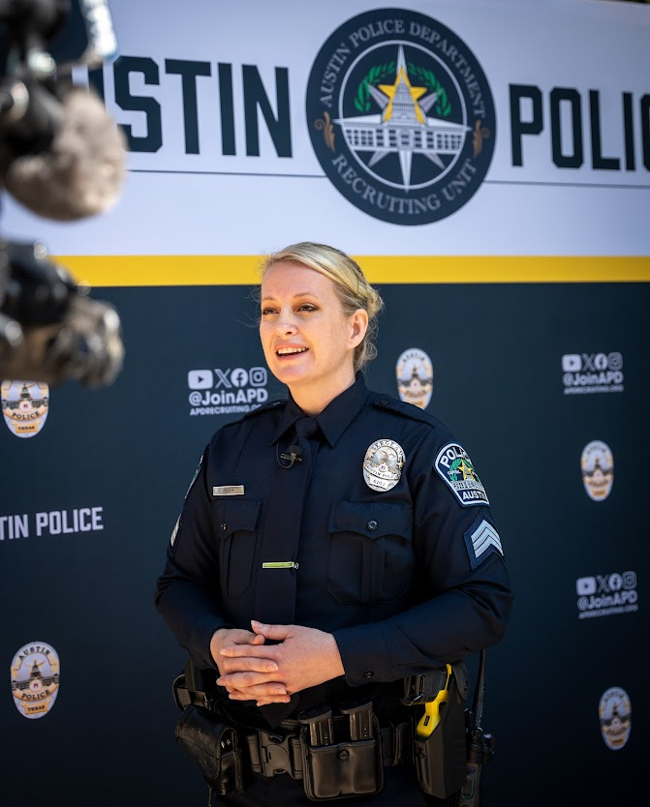
Phase Four: Launch
Following the launch of our strategic and collaborative initiatives, I promise to provide regular updates to the community on the progress of our work.
APD is committed to data-driven and results-oriented policing that will keep all members of our community safe.
9

Slide 10
Downtown Austin Business & Community Safety Initiatives
Public Engagement
Leverage justice and community service organization partnerships.
Increase data transparency to support community-involved crime prevention efforts.
Strategic Policing
Increase police visibility to promote public interaction and maintain public order.
Provide crime and strategy updates in newly established business sectors.
Holistic Governance
Establish a whole-of-government crime prevention working group led by City leadership.
Leverage Austin Regional Intelligence Center capabilities, partnerships, and City-wide resources for prevention efforts.
Expand business and public awareness/action campaigns.
Use data-driven and evidence-based patrol deployment and deterrence strategies.
Initiate problem-solving projects and investigations to block crime opportunities.
Coordinate with District City Council Members.
I am committed to empowering APD personnel to develop neighborhood-specific crime prevention plans, because every Austin community deserves to feel safe to live, work and thrive in our city.
These are some examples of how APD, City of Austin, and our business and community members can work together to address crime and safety concerns across our city.
10

Slide 11
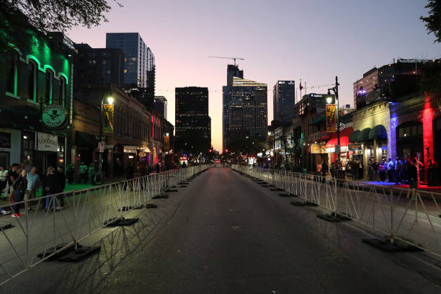
6th Street Safety – Pilot Program
APD is working with partner organizations to safely reopen East 6th Street to vehicular traffic during times that it is normally closed off.
Pilot summary:
Trial period will run from early December thru early March (ending prior to SXSW)
A combination of temporary (portable) fencing and rubber engineered curbs will be installed to keep pedestrians out of the street, and to keep vehicles from crossing into pedestrian areas
Stakeholder meetings have been held with area residential building owners, residents, bar/business owners and management staff
Data will be collected and analyzed to help inform future initiatives or long-term solutions
11

Slide 12
Downtown Crime Statistics
Top Offenses | Count
13B Simple Assault | 899
23H Theft: All Other Larceny | 590
35A Drug / Narcotic Violations | 506
23A Theft: Pocket Picking | 410
290 Destruction / Damage / Vandalism of Property | 342
35B Drug Equipment Violations | 338
13C Intimidation | 225
23F Theft: from Motor Vehicle (BOV) | 210
26B Fraud: Credit Card / ATM Fraud | 193
520 Weapon Law Violations | 142
240 Motor Vehicle Theft | 135
13A Aggravated Assault | 116
TOP OFFENSES Total | 4106
Top Offenses make up about 90% of total activity (4561-count) in George sector. When viewing sector activity by category, about 50% of are Crimes Against Property, followed by Crimes Against Persons (28%) and Crimes Against Society (22%). Overall, trends have remained stable throughout 2024 so far.
Increased and/or elevated counts may be the reflection of increased presence of enforcement as officers regularly engage in proactive, focused efforts to better address overall sector activity. I.e., proactivity leads to an increase in police response; increase in reports and/or arrests; increase in count.
Analyst Note: Data is sourced from the Open Data Hub, which mimics the Open Data Portal. Top Offense table refers to NIBRS description. Category graph refers to NIBRS category.
12

Slide 13
Downtown Crime Statistics
Top Victimization TYPES* | Count
Assault | 119
Theft | 41
*Assault and Theft represent broad categories which display the sum of multiple, correlating offense types
Data indicates a majority of victimizations take place generally between Congress Ave / N IH-35 SVRD and E 4th St / E 8th St.
This may be attributed to the higher level of foot traffic in the area, contributing to the likelihood for an interaction to occur.
*NOVEMEBR 2024 DATA DOES NOT REFLECT A FULL MONTH: 11/1/2024 – 11/11/2024
*
*
According to data, assault- and theft-related victimizations are the most common affecting individuals experiencing homelessness in George sector.
Data displaying counts by month, generally, follow that rates are stable with some observed fluctuations around those seasonal months (Jan, Apr-Jul) – which may be attributed to the ebb and flow of persons traveling in/out of the city.
Generally, data indicates that victimizations are higher during times when there may be more transition in the area (e.g., start/end of a typical work-day, late night/early morning entertainment hours).
Analyst Note: Please caution that victim data for this slide is pulled based on the address associated with each victim; data relies on the accuracy of victim address which can be skewed if an individual does not disclose their housing status. Data was captured in this dataset if the corresponding victim had a listed address for either Transient, 500 E 7th St (ARCH), or 501 E 8th St (Salvation Army Shelter).
13
Notes:
Assault count includes Simple Assault, Aggravated Assault, Intimidation, and Assault Information
Theft count includes Theft: All Other Larceny, Pocket Picking, and Theft Information

Slide 14
Downtown Crime Statistics
Tellers | Count
13B Simple Assault | 7
35A Drug / Narcotic Violations | 2
240 Motor Vehicle Theft | 1
TOTAL | 10
Space siete | Count
13B Simple Assault | 3
35A Drug / Narcotic Violations | 2
23H Theft: All Other Larceny | 1
TOTAL | 6
The cut | Count
13B Simple Assault | 1
290 Destruction / Damage / Vandalism of Property | 1
23H Theft: All Other Larceny | 1
TOTAL | 3
Three after hour establishments in George sector: Tellers – Space Siete – and The Cut
Data indicates that simple assaults are common across all three establishments; drug / narcotic and other destruction and/or theft related activity appears to occur as well.
A majority of activity at these establishments take place during hours 0200-0600 – which align with the operating hours of an after-hour establishment. Typically (though not always), these types of establishments open around or at 2am which may explain the absence of activity in the hours leading up to “bar close” – as is typically observed with a regularly-operating bar establishment.
Analyst Note: Data is sourced from the Open Data Hub, which mimics the Open Data Portal. Data is pulled based on street address but presented on the slide according to establishment name.
14

Slide 15
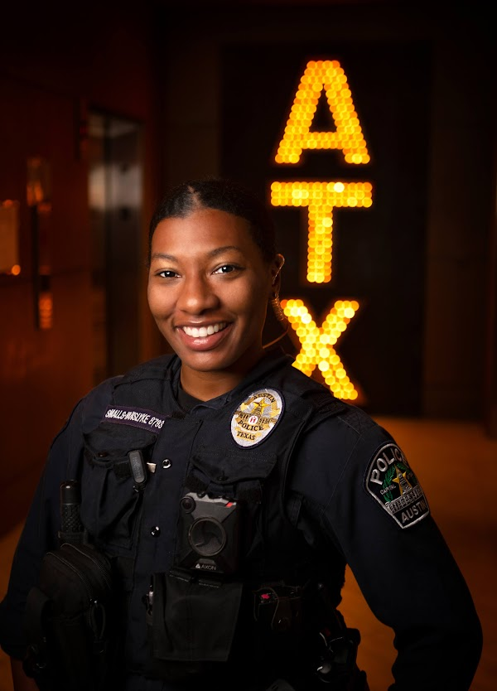
Stay Connected with APD
Please follow us on Social Media! Here, you'll find information about community events, department initiatives, neighborhood crime statistics, and so much more!
APD Facebook
www.facebook.com/AustinPolice
www.facebook.com/APDenEspanol
APD Instagram
Austin Police Department (@austin_police)
APD X
Austin Police Department (@Austin_Police) / X
15

Slide 16
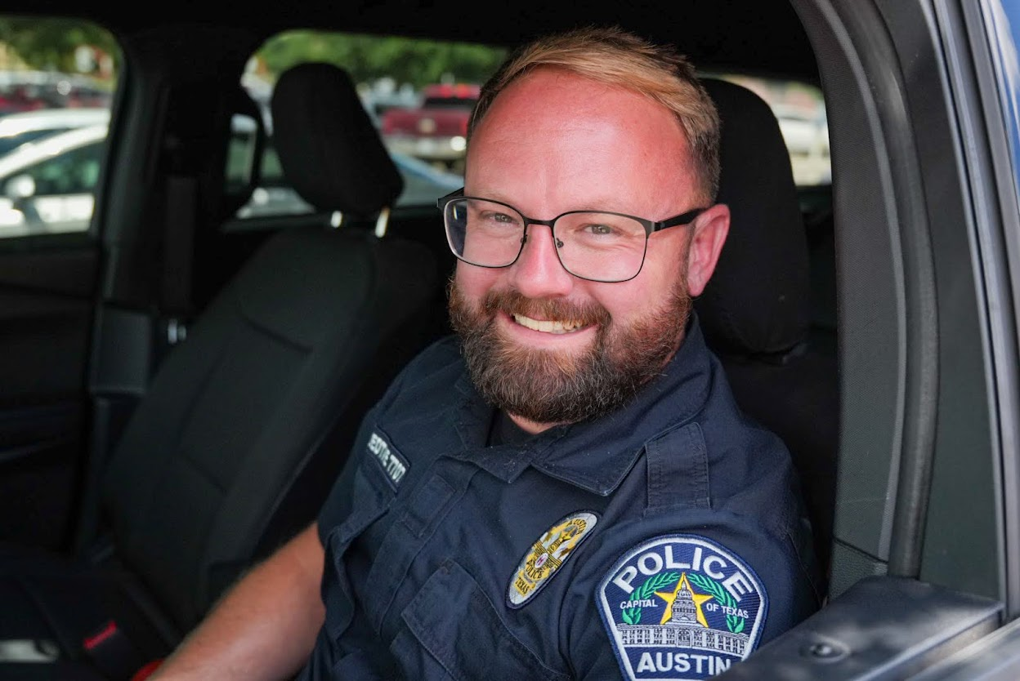
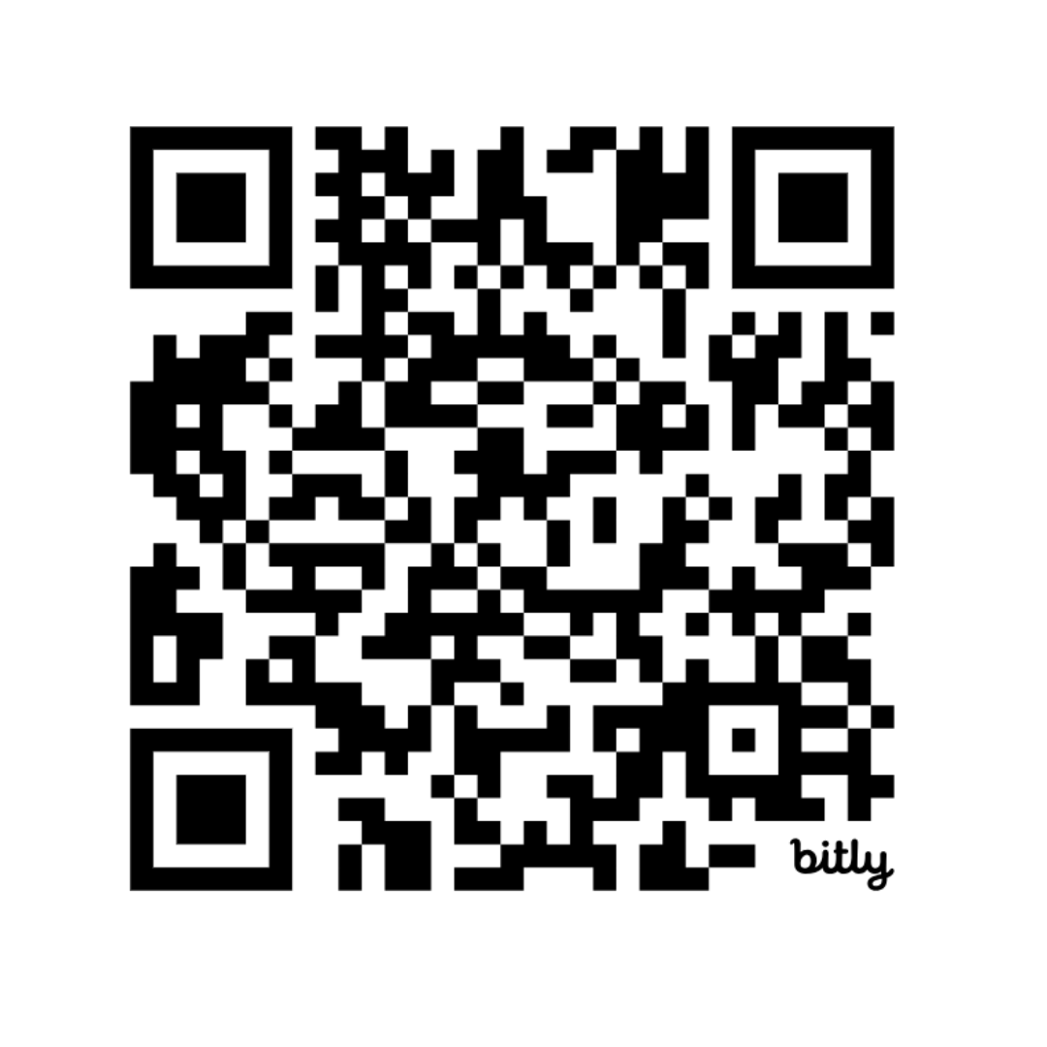
Ride with an Officer
APD Ride Along
Visit our website to see the list of disqualifiers and apply to ride along:
Apply to the APD Ride Along Program | AustinTexas.gov
Or scan the QR code!
If you have questions email, APDRideAlong@austintexas.gov
If you want to learn more about the Austin Police Department and what our officers do on patrol, riding along with an officer is a great way to do that!
16

Slide 17
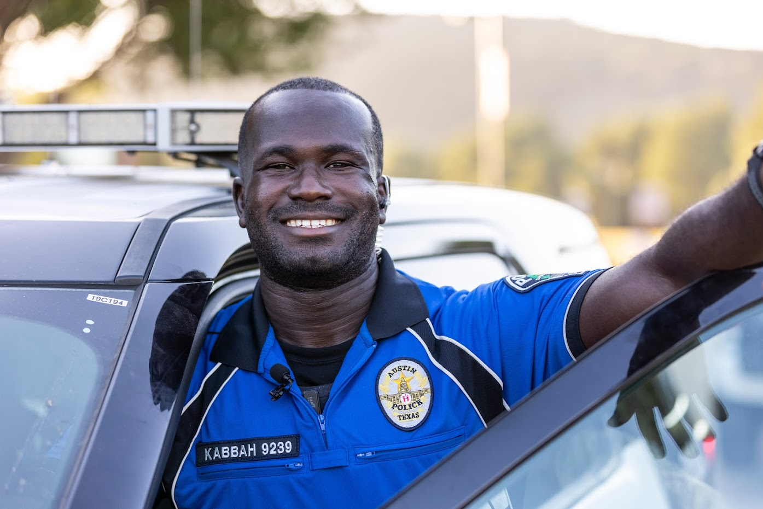
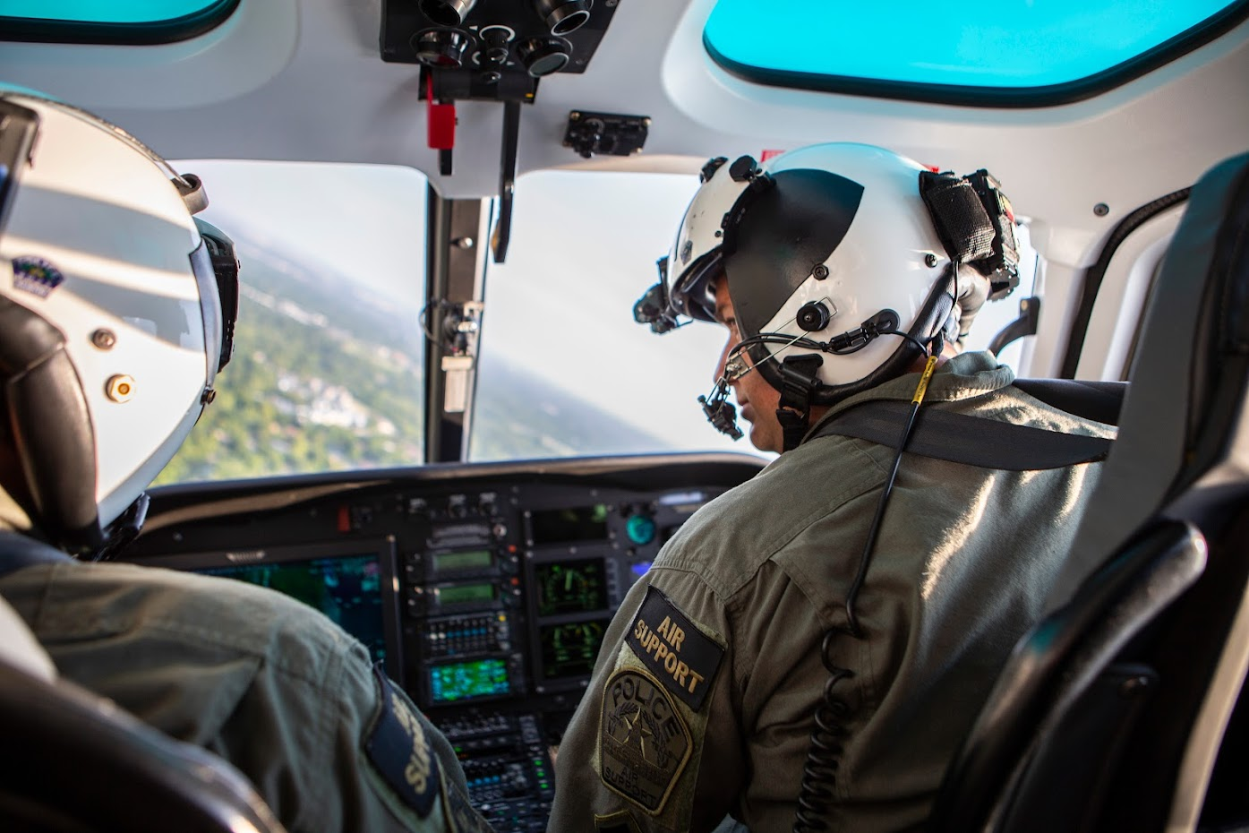
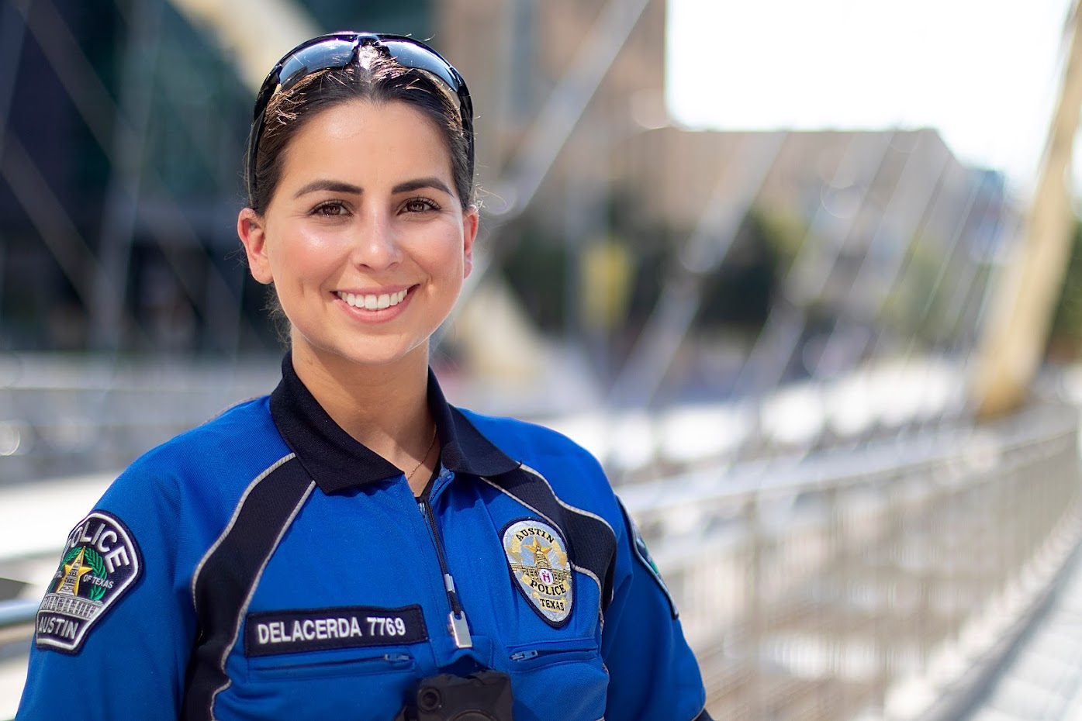
Thank You
Austin Police
Department

